Slide 1

PII Detection using Semi-Supervised Learning
Jithesh KB
Poojashree NS
Priyanka Math
Tharun Mukka
Project Advisor: Vijay Eranti

Slide 2
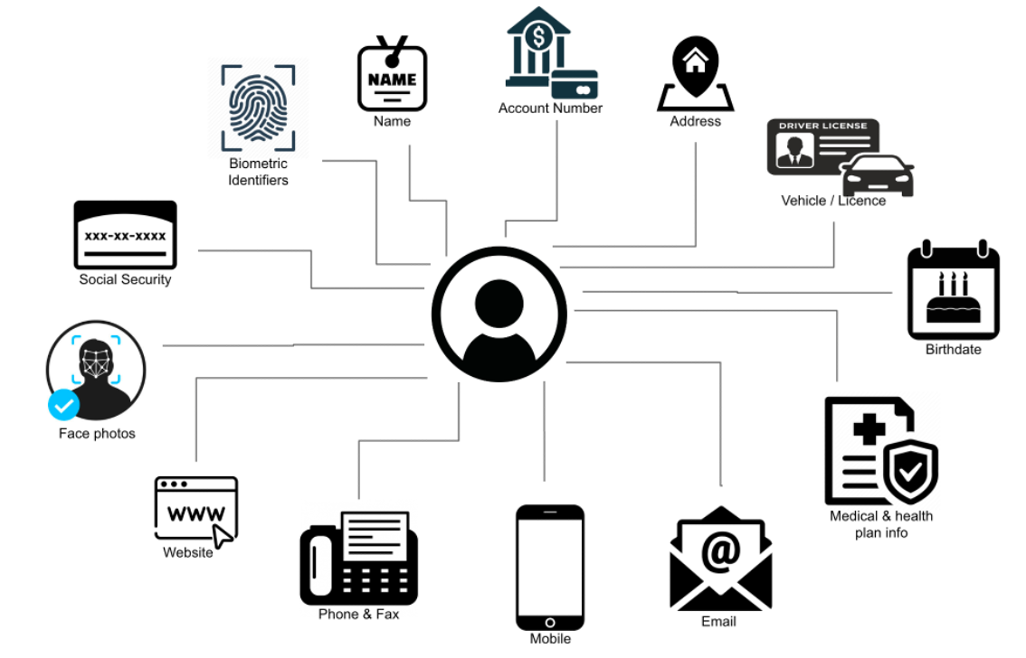
INTRODUCTION
Personally Identifiable Information (PII) - Personal information that can be used to identify a person or their particular circumstances.
With just a few bits of personal information, a person's identity can be compromised, and criminals can carry out fraudulent activities

Slide 3
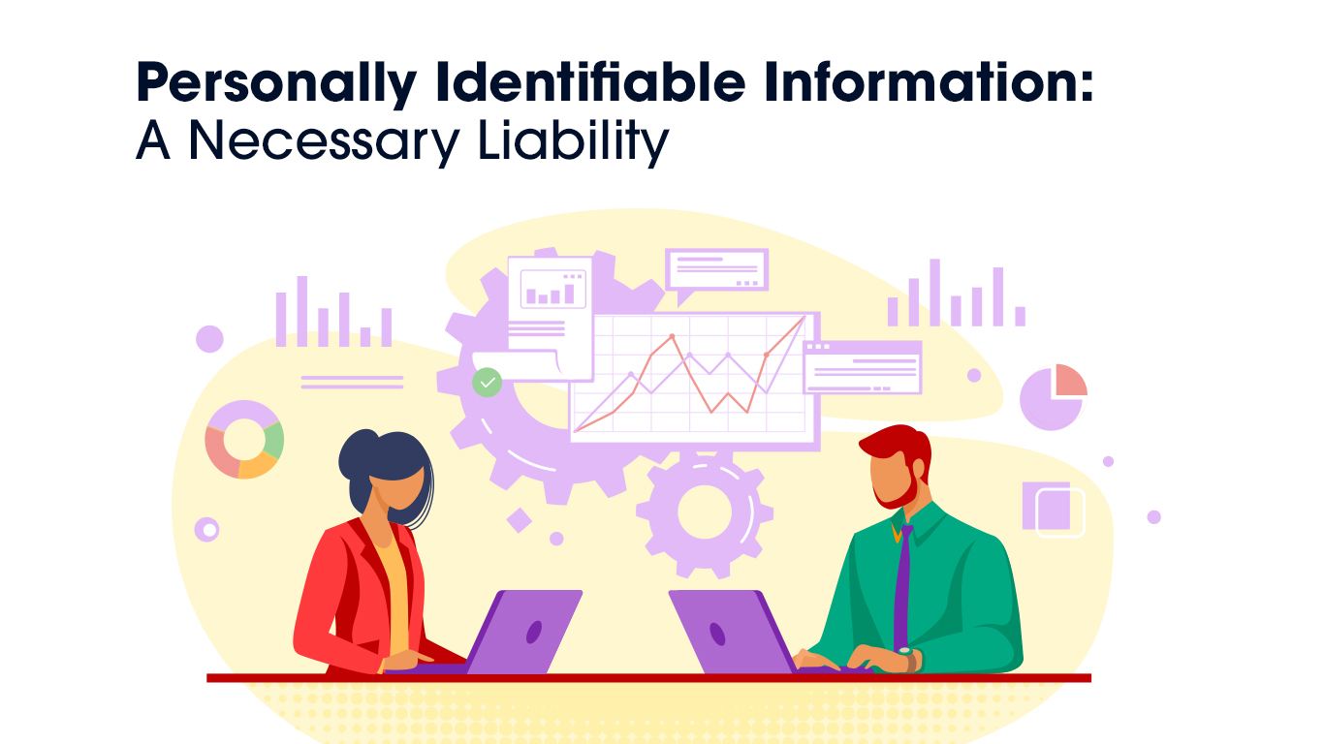

Slide 4
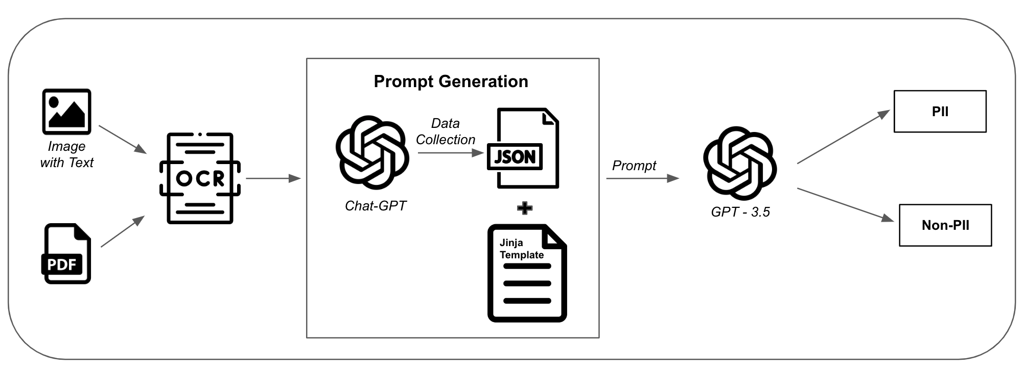
Generic PII Detection

Slide 5
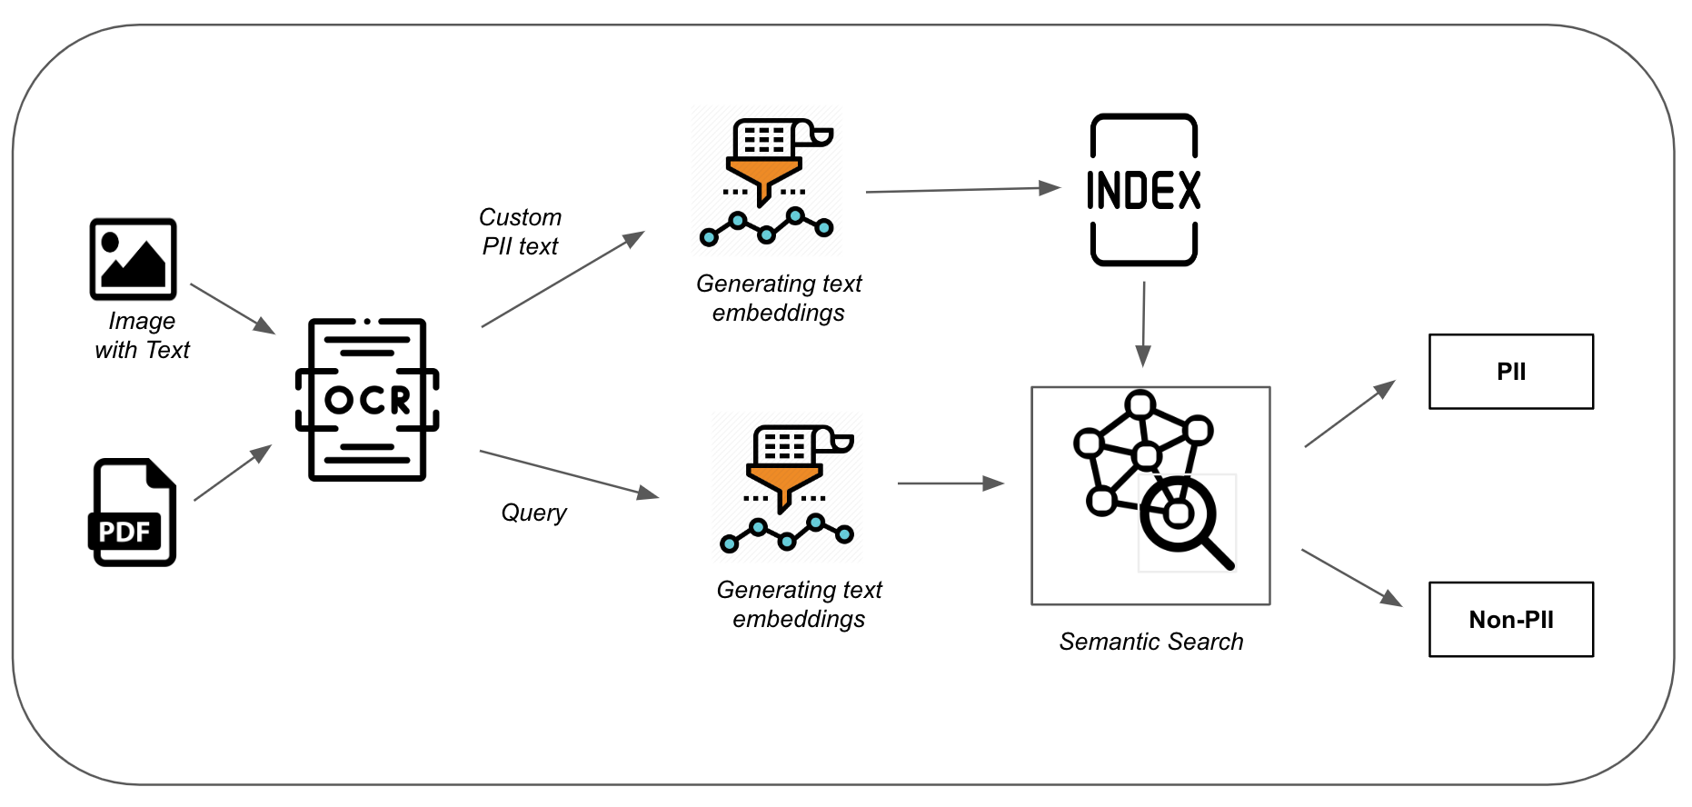
Custom PII Detection

Slide 6

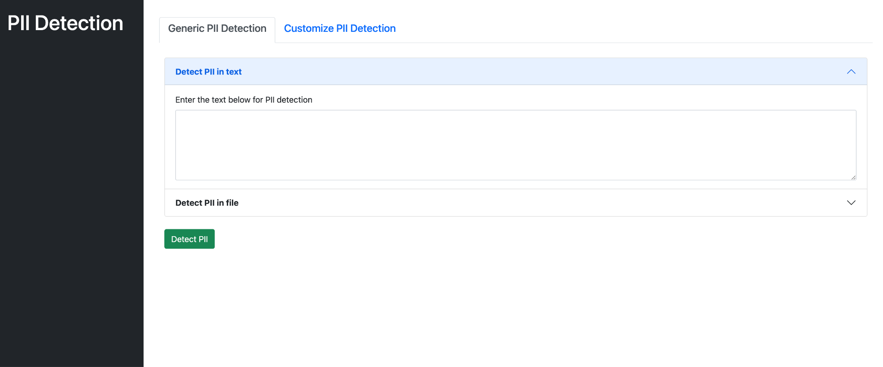
Demo

Slide 7
Thank you

